Slide 1


Slide 2



BPO in Bangladesh
Past, Present, And Future of BPO in Bangladesh

Slide 3
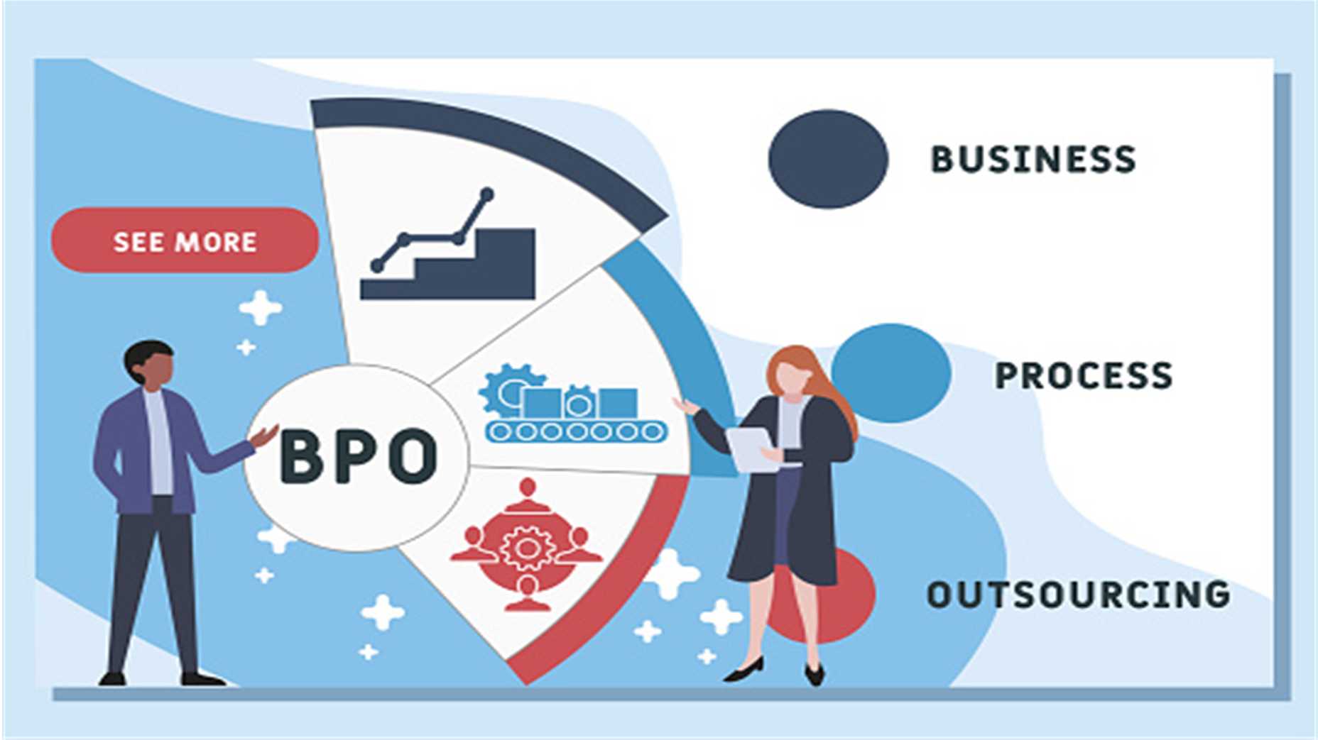




Hello, there is a work for data entry.
How much will you pay?
20$ for the entire project.
A type of outsourcing is where a third-party provider is employed to carry out one or more business functions in a company.
That is too low.
$25??
Deal!!

Slide 4
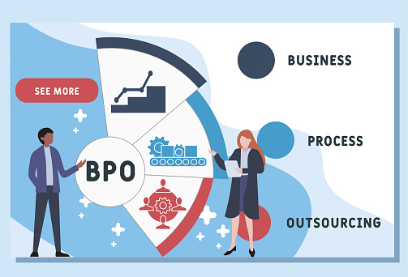

Slide 5
Hello, there is a work for data entry.
How much will you pay?
20$ for the entire project.
A type of outsourcing is where a third-party provider is employed to carry out one or more business functions in a company.
That is too low.
$25??
Deal!!

Slide 6

The Past of BPO In Bangladesh.
Challenges
History

Slide 7



In 2009
The Past of BPO In Bangladesh.
Challenges
History
One of the largest conglomerates in this country and currently has around 500 employees providing services to US companies such as AOL, AdTheorent, and ScrollMotion

Slide 8
Workforce Growth In BPO Sector.
The Past of BPO In Bangladesh.
Challenges
History
BPO industry Revenue Growth.

Slide 9





Health Concerns.
Employee Attrition.
The Past of BPO In Bangladesh.
Customer Attrition.
Challenges
History
Frequent Disruption
Scarcity of Talent.

Slide 10

The Present of BPO In Bangladesh.
The Present of BPO In Bangladesh.
Challenges to Opportunity
Present Situation
Challenges

Slide 11




Business Process Outsourcing, or BPO, is growing at a massive rate across the world, but Bangladesh’s growth in this sector is being choked due, as the sector's people say, to the skill gap, talent crunch, and lack of public patronage.
The Present of BPO In Bangladesh.
The Present of BPO In Bangladesh.
Present Situation
Challenges to Opportunity
Challenges
Huge Population
Government Support
Factors That Make Bangladesh Destination For BPO
Cheaper Infrastructure Cost
Cheaper Manpower

Slide 12




The Present of BPO In Bangladesh.
The Present of BPO In Bangladesh.
Lack of
Skills
Lack of Skilled Manpower
Present Situation
Challenges to Opportunity
Challenges
Problem In Payment Gateway
Transportation Problem

Slide 13




Skilled Workforce
Giving
Effort
The Present of BPO In Bangladesh.
Present Situation
Challenges to Opportunity
Challenges
Latest Technology
Improve Telecommunication

Slide 14
The Present of BPO In Bangladesh.
The Present Sectors of BPO In Bangladesh.
Present Growth Sectors
Present Growth Sectors
Continued
Continued

Slide 15


The Present of BPO In Bangladesh.
Present Growth Sectors
Present Growth Sectors
Information Technology (IT) and IT-enabled services
Finance
and Accounting
Continued

Slide 16



The Present of BPO In Bangladesh.
Present Growth Sectors
Present Growth Sectors
Information Technology (IT) and IT-enabled services
Finance
and Accounting
Customer Support
E-Commerce
Continued

Slide 17

The Present of BPO In Bangladesh.
The Future of BPO In Bangladesh.
BPO As IT Supporter
Future BPO Potentials

Slide 18

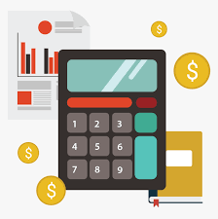


Supporting Customer
Finance & Accounting
The Present of BPO In Bangladesh.
The Future of BPO In Bangladesh.
BPO As IT Supporter
BPO As a Potential Game Changer.
Future BPO Potentials
Digital
Services
Health Care

Slide 19




E-Commerce Enhancing
The Future of BPO In Bangladesh.
BPO As IT Supporter
Future BPO Potentials
BPO As A Pillar IT
Research & Analytics
HR Outsourcing

Slide 20
The Present of BPO In Bangladesh.
The Future of BPO In Bangladesh.
Steps Which will Build Reputation Too
Steps To Improve Future

Slide 21



Continued Government Support
Steps That Will Make Strong The Basement of BPO.
The Future of BPO In Bangladesh.
Steps Which will Build Reputation Too
Steps To Improve Future
Skilled Workforce
Competitive Cost Advantage

Slide 22



Continued Government Support
Industry Diversification.
Steps That Will Make Strong The Basement of BPO.
The Future of BPO In Bangladesh.
Steps To Improve Future
Steps Which will Build Reputation Too
Technological Advancements.
Skilled Workforce
Growing International Reputation.
Competitive Cost Advantage

Slide 23
T
H
A
N
K
Y
O
U

